Slide 1


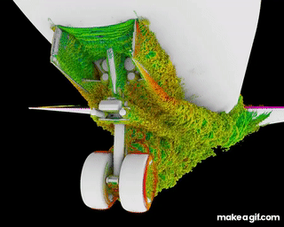
Linear Stability Analysis of Plane Channel Flow
Part of the course Computational Fluid Mechanics II
B.Sc. Jousef Murad - July 17th, 2018
Institute for Hydrodynamics – Prof. Dr. Markus Uhlmann

Slide 2
Outline
1
Motivation
2
History & Theoretical Background
3
Assignment
4
Implementation
5
Difficulties
6
Results & Outlook

Slide 3
Motivation
OS Equations govern the stability of shear and related flows
Climate Modelling:
Mid-latitude cyclone → high and low pressure regions
Shear Flows in electrohydrodynamic (EHD)
Clutch development or high voltage generators
Flow over an airfoil covered in de-icer
Notes:
TESTTEST

Slide 4
Motivation
“Linear growth mechanisms are the only responsible for disturbance growth in shear flows, where nonlinear terms redistribute energy and give zero net contribution when integrated over the whole control domain” – T. Ellingsen, E.Palm
Notes:
In shear flows main linear mechanism for transient disturbance growth is the lift-up effect that produces low and high speed streaks in the streamwise velocity
Near wall turbulent structures are not formed in their proper scales without nonlinear terms in NSE, thus indicating that the formation of the commonly observed near wall turbulent structures is essentially non-linear but their maintenance relies on linear processes.

Slide 5
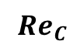
History & Theoretical Background
Reynolds (1883)
A(t)
Supercritical
X
Subcritical
X
Re
$${Re}_{C}$$
G.I. Taylor vs. Prandtl-Tollmien-Schlichting → Schubauer & Skramstad experiment HTS waves

Slide 6
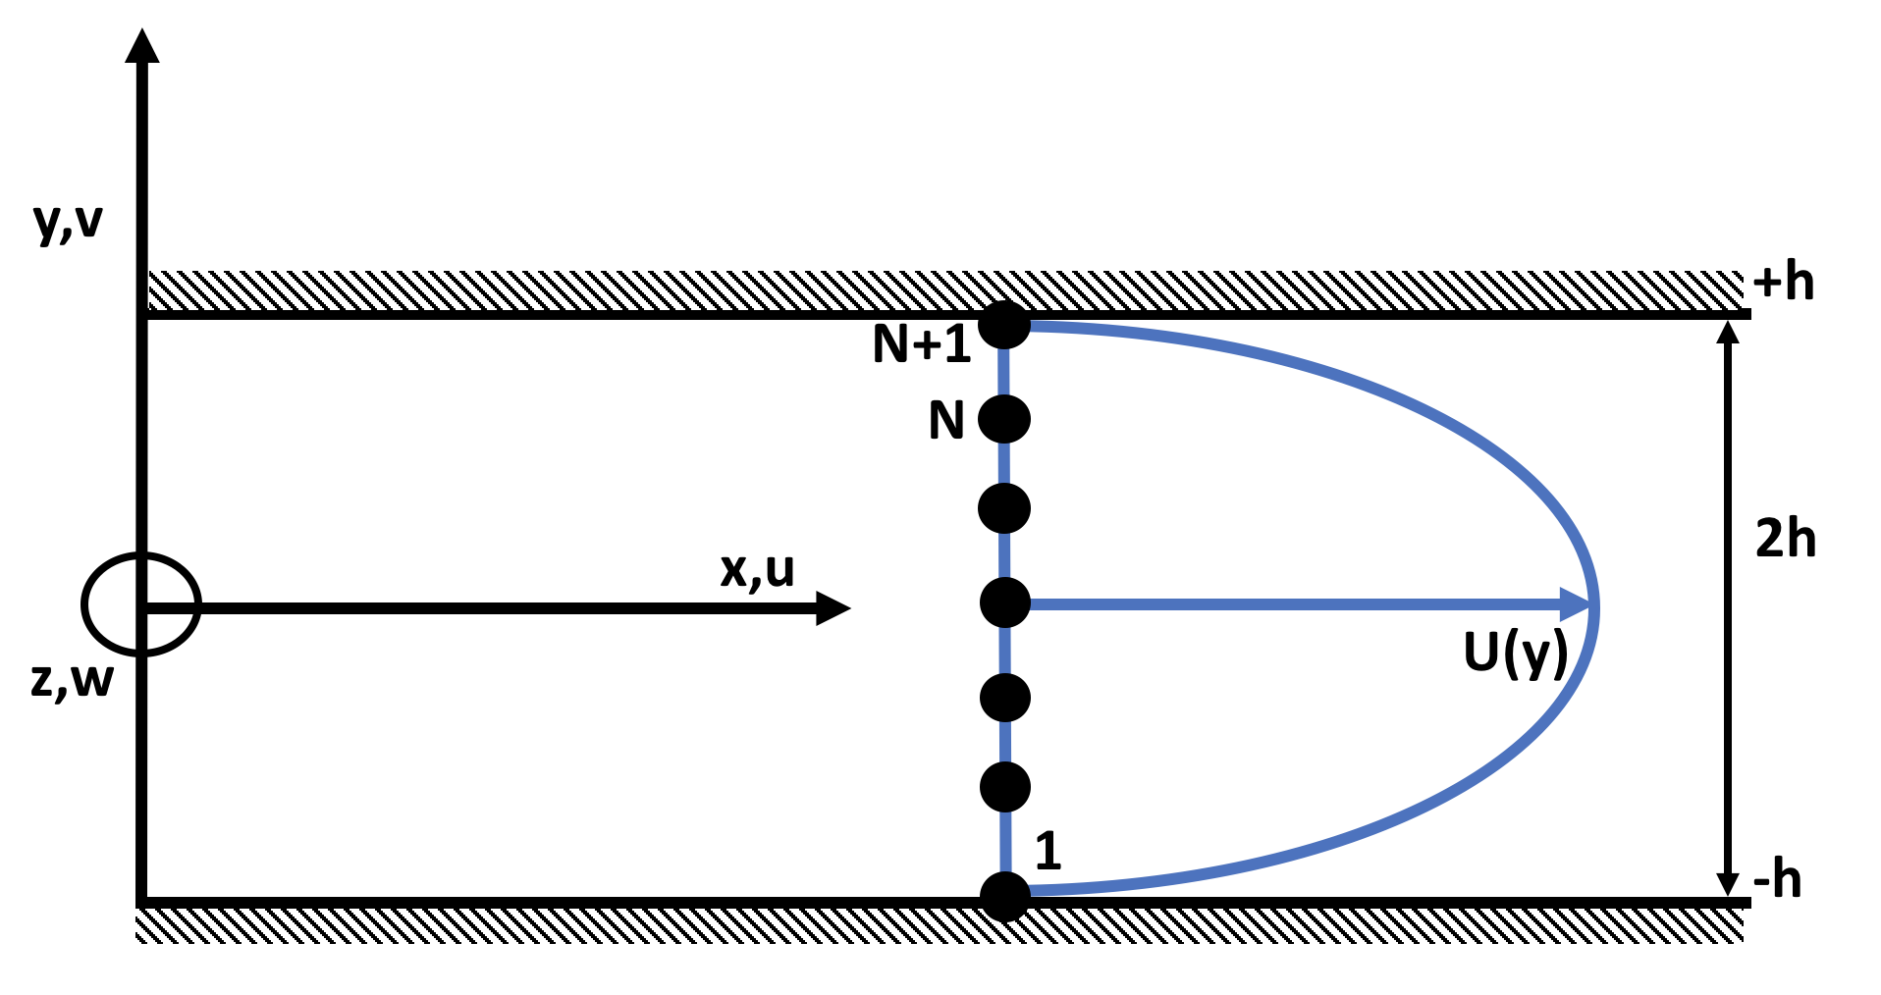
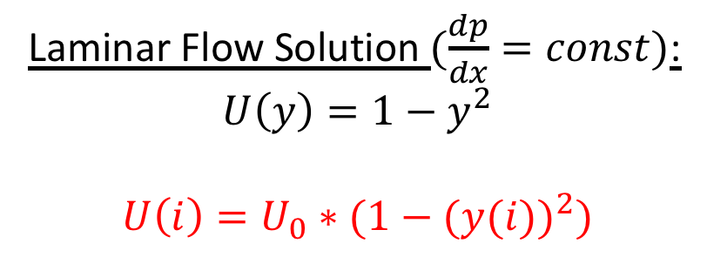
Assignment
Laminar Flow Solution $(\frac{dp}{dx}=const)$:
$$U\left(y\right)=1−y^{2}$$
$$U\left(i\right)=U_{0}∗(1−{(y(i))}^{2})$$
Boundary Conditions:
No-slip
→ f(-1) = f(1) = 0
No-Penetration
→ f’(-1) = f’(1) = 0

Slide 7
Squire‘s theorem
To obtain the minimum critical Reynolds number it is sufficient to consider only two-dimensional disturbances!

Slide 8
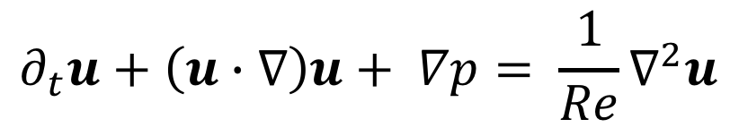
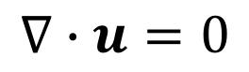
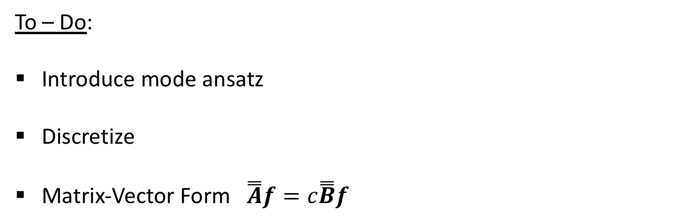
Assignment
$$∇∙u=0$$
$$∂_{t}u+\left(u∙∇\right)u+ ∇p= \frac{1}{Re}∇^{2}u$$
To – Do:
Introduce mode ansatz
Discretize
Matrix-Vector Form $\overset{̿}{A}f=c\overset{̿}{B}f$

Slide 9
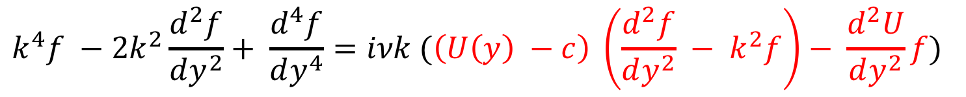
Orr-Sommerfeld Equation
$$k^{4}f −2k^{2}\frac{d^{2}f}{dy^{2}}+ \frac{d^{4}f}{dy^{4}}=iνk (\left(U\left(y\right) −c\right) \left(\frac{d^{2}f}{dy^{2}} − k^{2}f\right)− \frac{d^{2}U}{dy^{2}}f)$$
$$iνk\left(−2\frac{d^{2}f}{dy^{2}}+ k^{2}f\right)+\frac{iν}{k}\frac{d^{4}f}{dy^{4}}+U\left(y\right)\left(\frac{d^{2}f}{dy^{2}} − k^{2}f\right)− \frac{d^{2}U}{dy^{2}}f=c\left(\frac{d^{2}f}{dy^{2}} − k^{2}f\right)$$

Slide 10
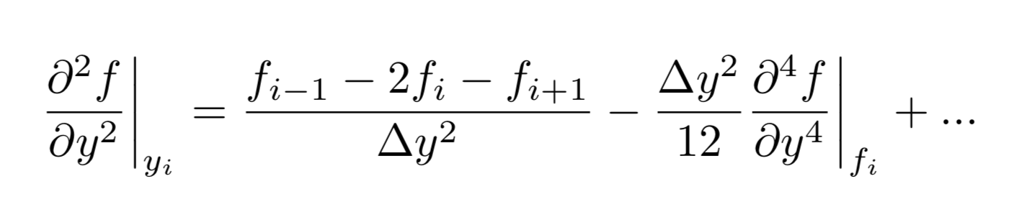
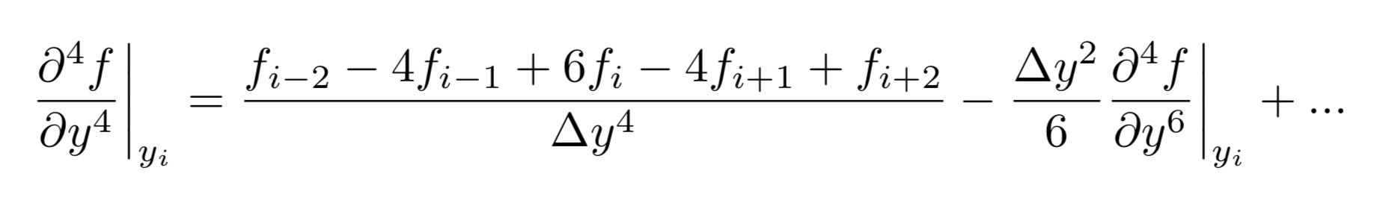
Finite-Difference Schemes

Slide 11


Implementation (Flow Chart)
Input
Discretize $∆y$
Discretize Position and Velocity
Pre-Allocate Matrices (2nd and 4th order)
Array/Range for $∝$ & Re

Slide 12
eig(A,B)
Calculate Growth Rate
Sort Growth Rate & Extract Max.
Plot Eigenvalue Spectrum
End Loop
No
Yes
Plot (2D, log-log, Contour…)

Slide 13
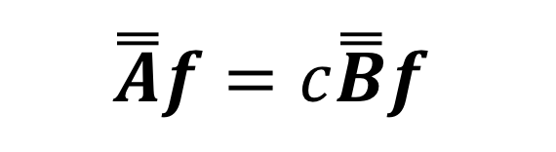
Implementation
$$iνk\left(−2\frac{d^{2}f}{dy^{2}} + k^{2}f\right)+\frac{iν}{k}\frac{d^{4}f}{dy^{4}} +U\left(y\right)\left(\frac{d^{2}f}{dy^{2}} − k^{2}f\right)− \frac{d^{2}U}{dy^{2}}f=c\left(\frac{d^{2}f}{dy^{2}} − k^{2}f\right)$$
$$\overset{̿}{A}f=c\overset{̿}{B}f$$

Slide 14

Difficulties
Debugging tricky
Convergence Study & Plots

Slide 15
Results
Time to solve Eigenvalue problem
Accuracy of imaginary Part
Convergence Study
Eigenvalue Spectrum
Stability

Slide 16
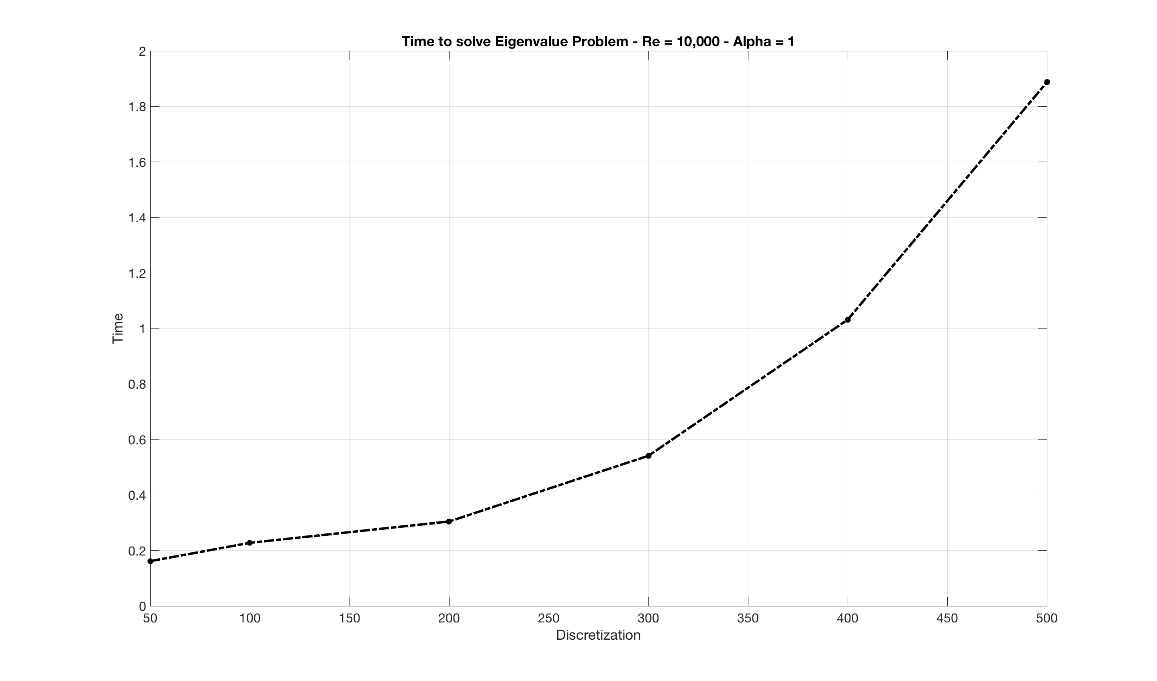
Time to solve Eigenvalue Spectrum

Slide 17
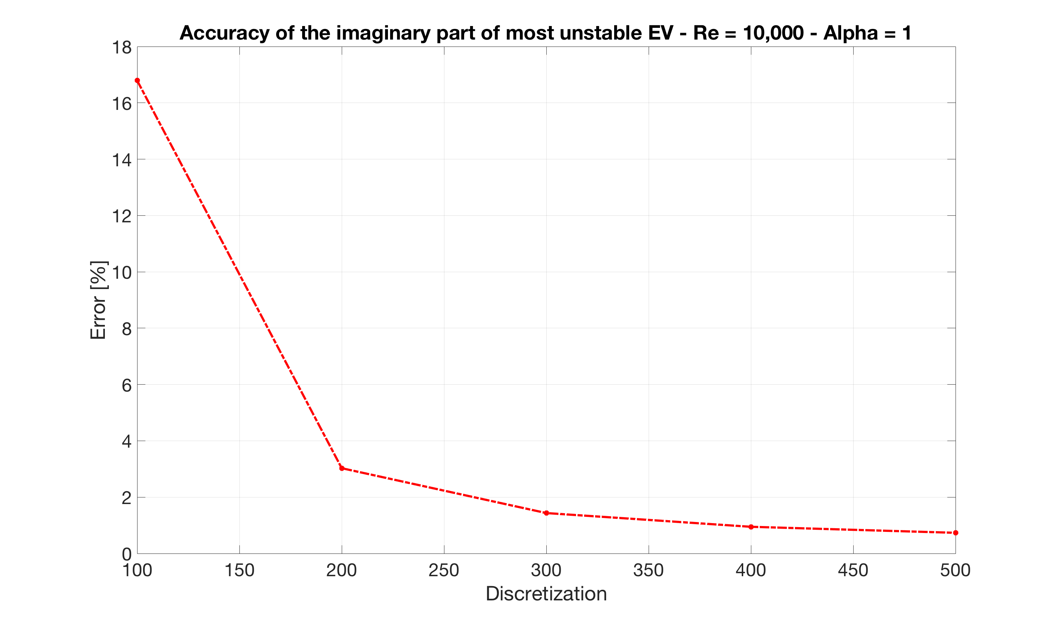
Accuracy of imaginary part

Slide 18
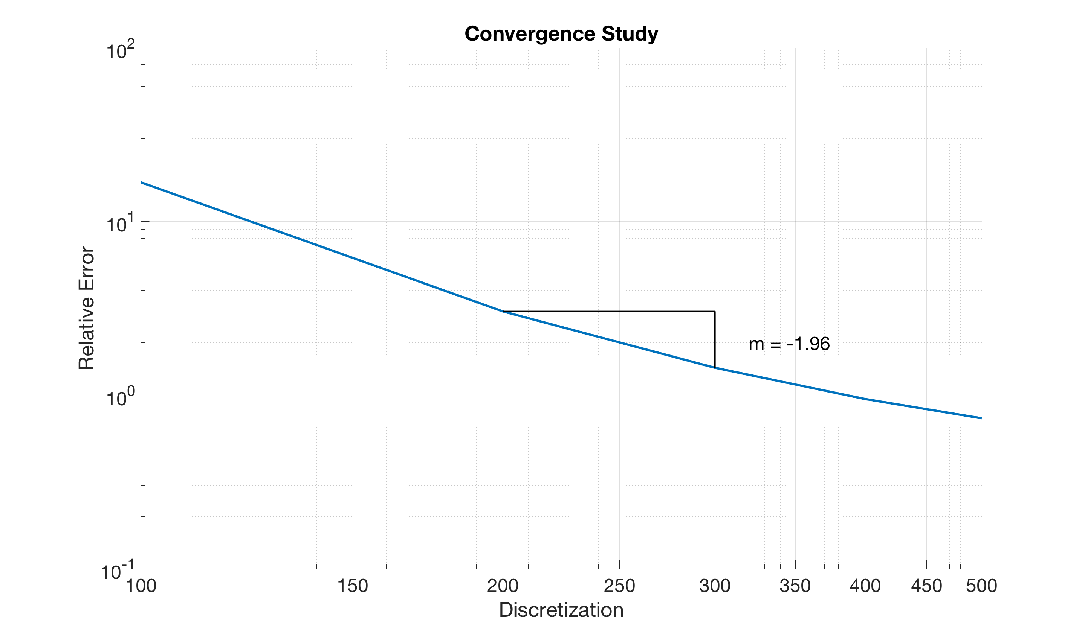
Convergence Study

Slide 19
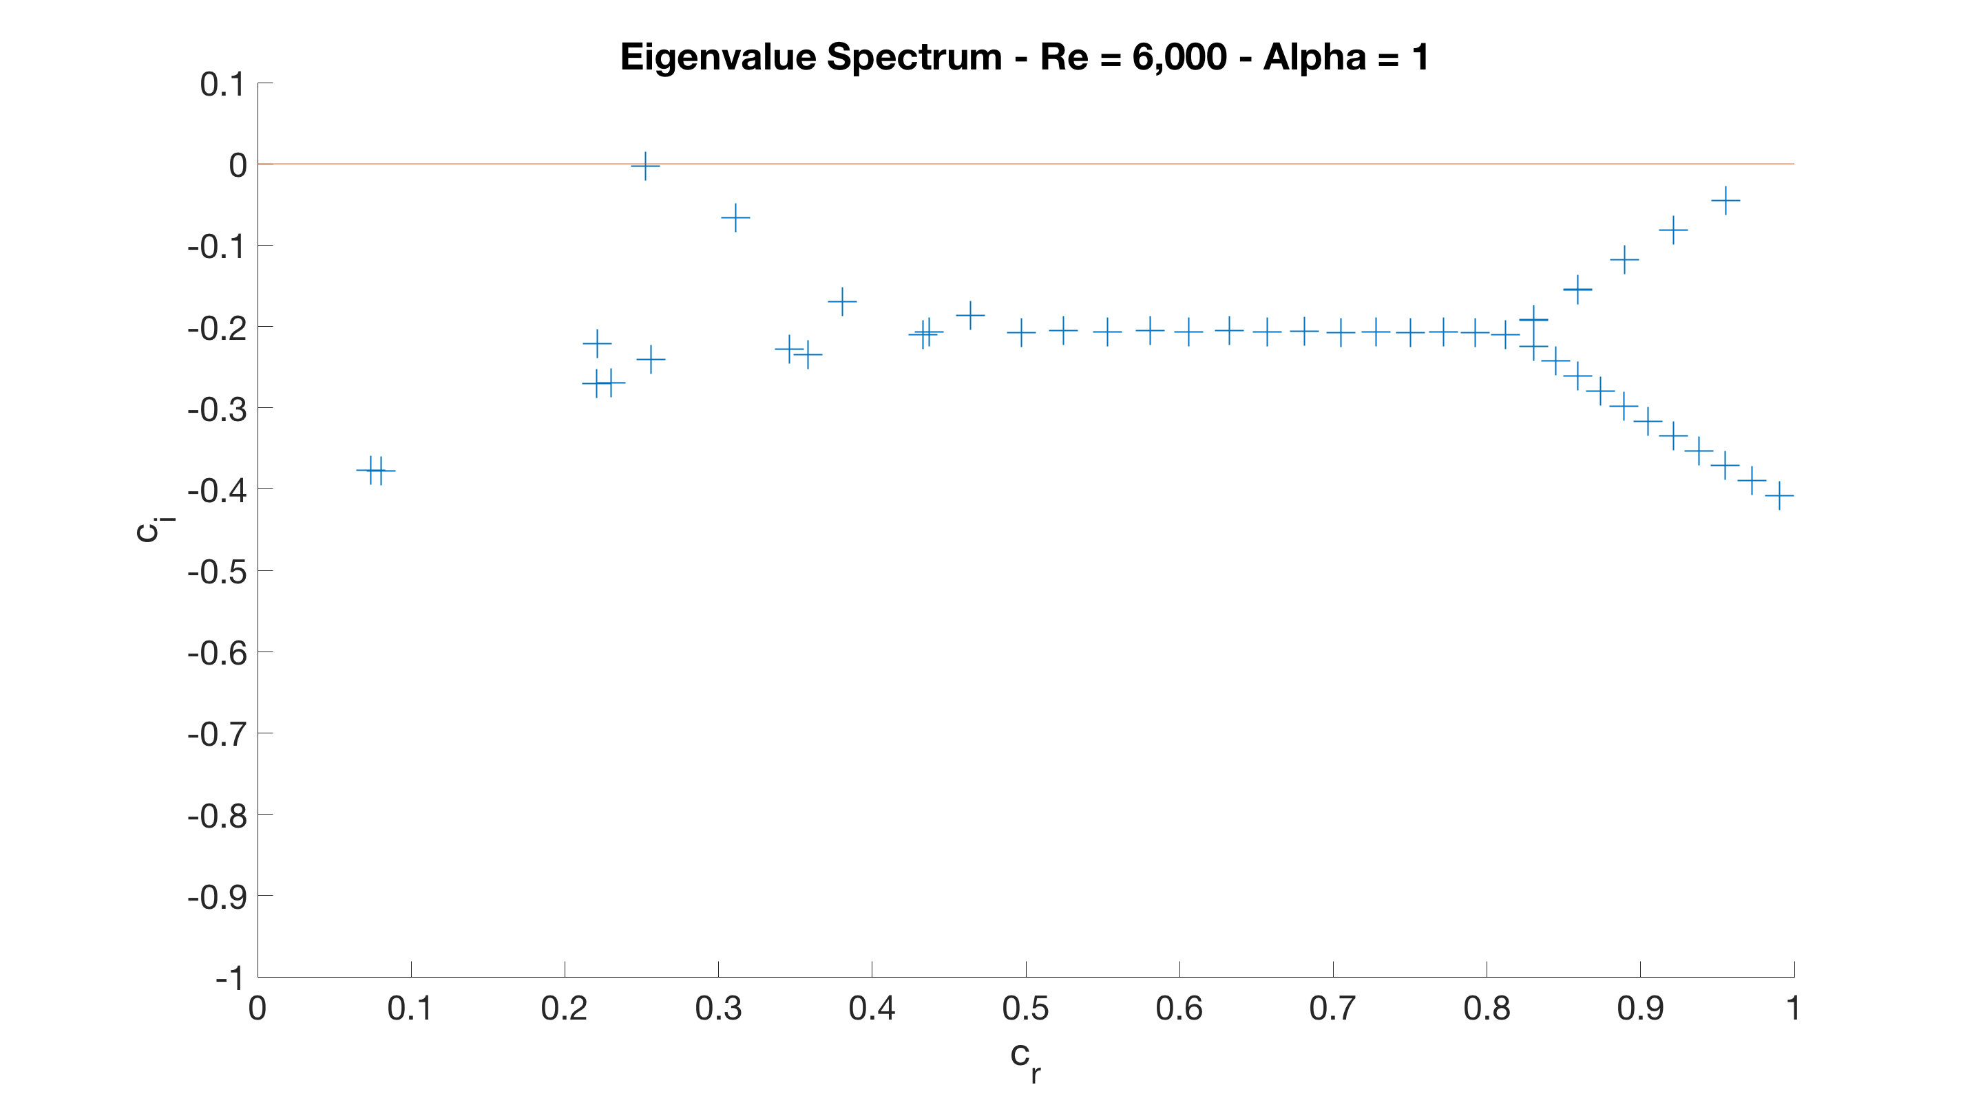
Eigenvalue Spectrum N = 50

Slide 20
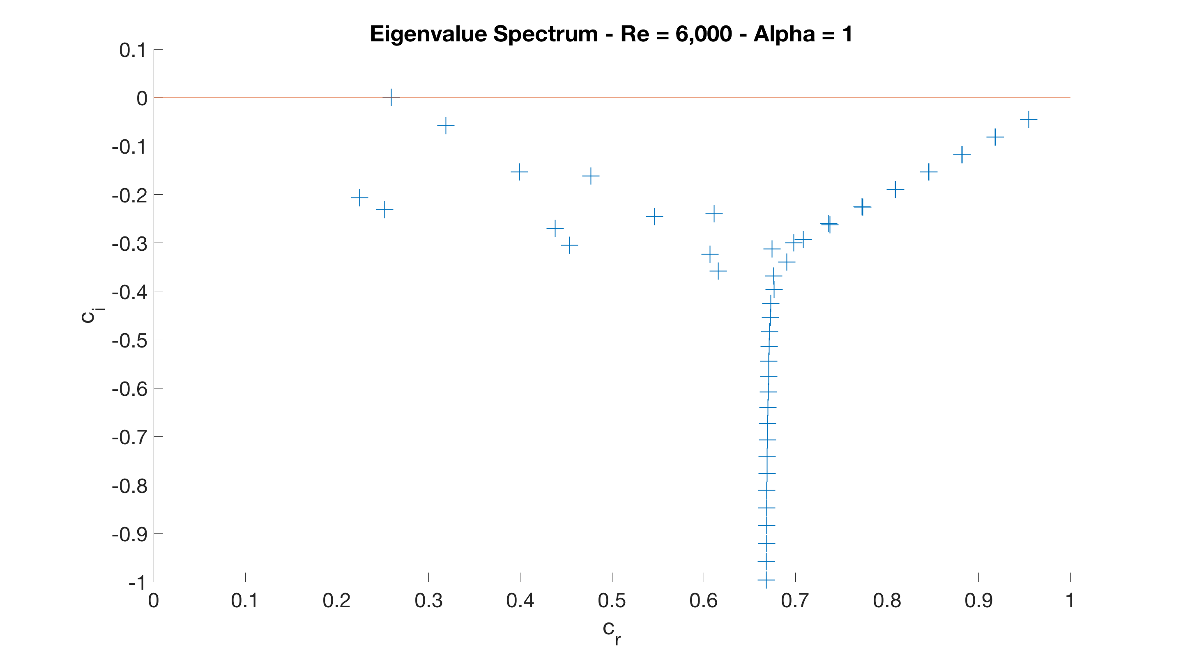
Eigenvalue Spectrum N = 200
A
P
S
Notes:
Points near branch sensitive to change

Slide 21
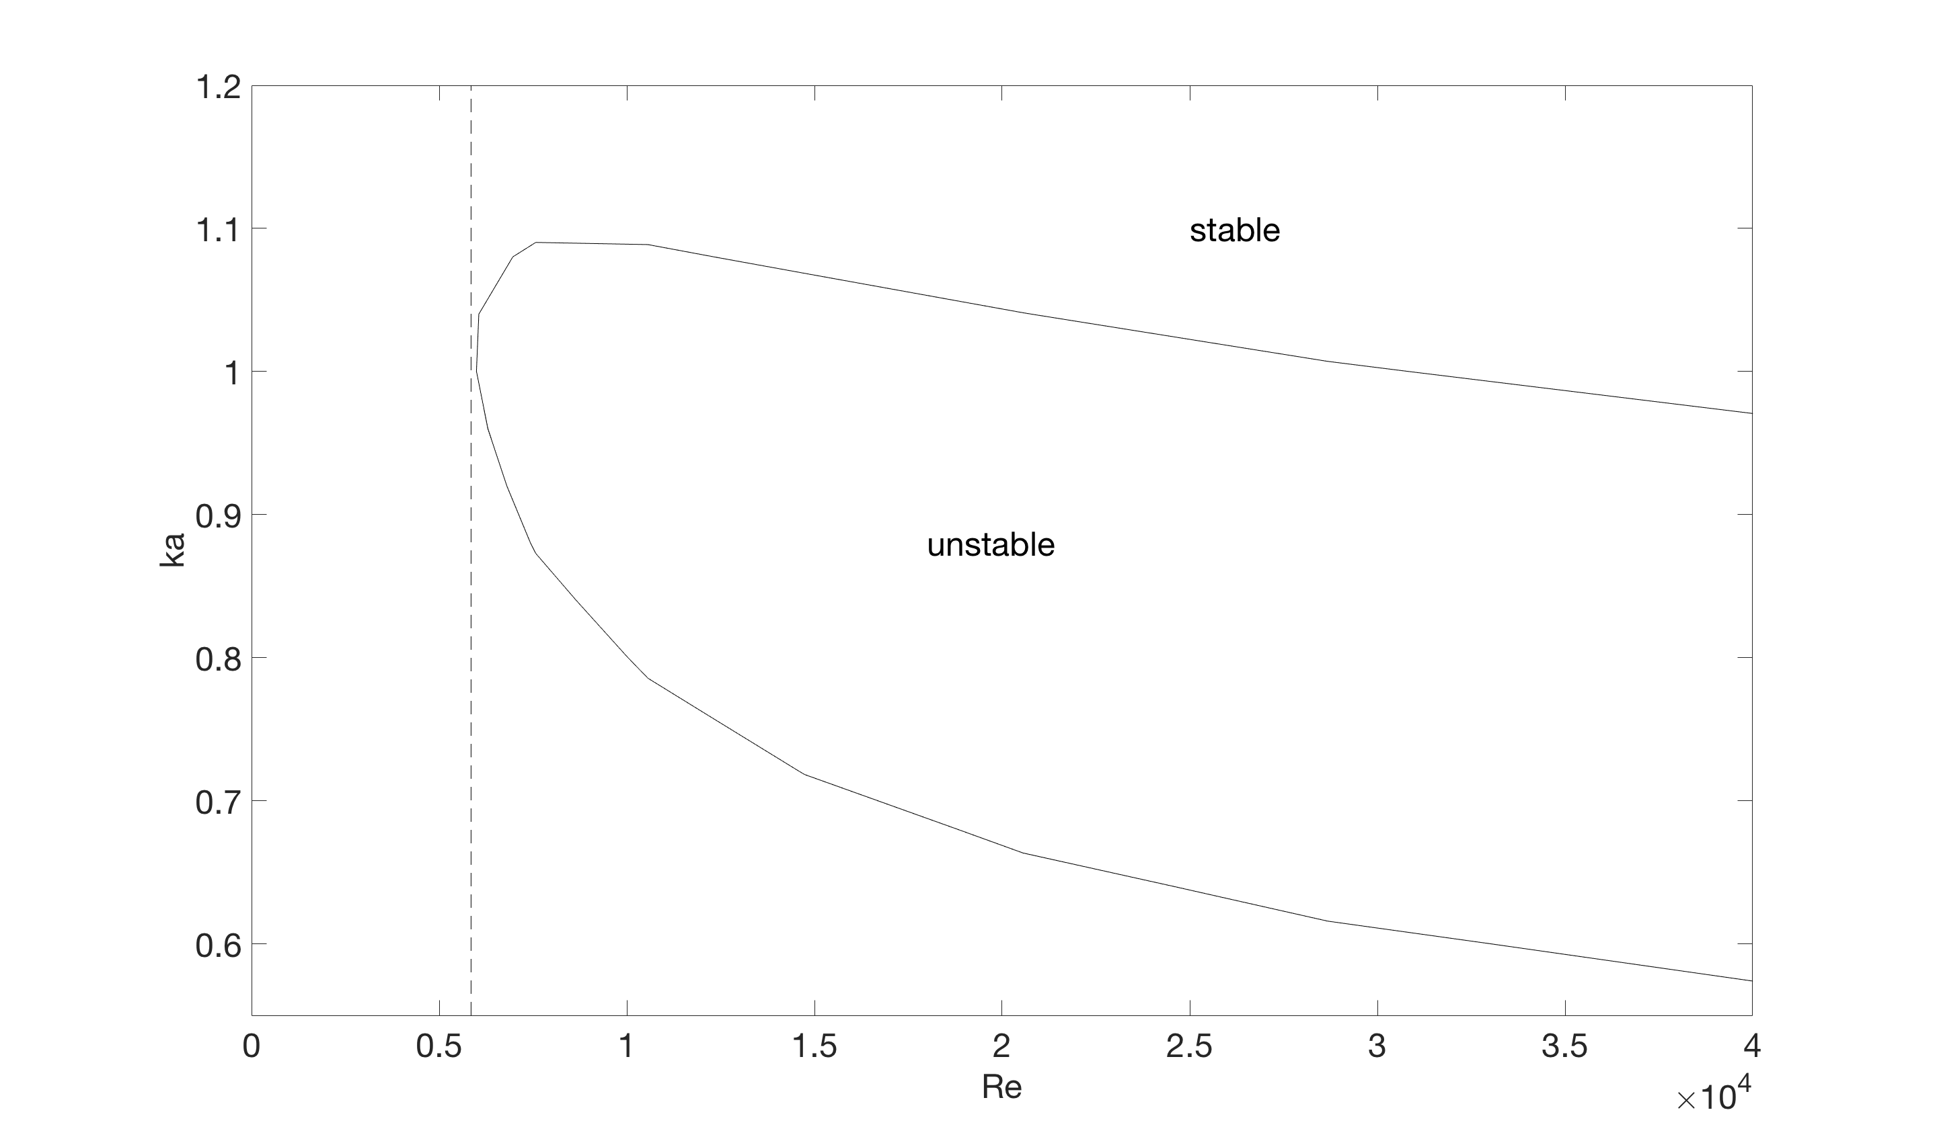
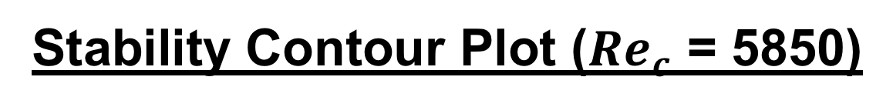
Stability Contour Plot (${Re}_{c}$ = 5850)
Notes:
Points near branch sensitive to change

Slide 22
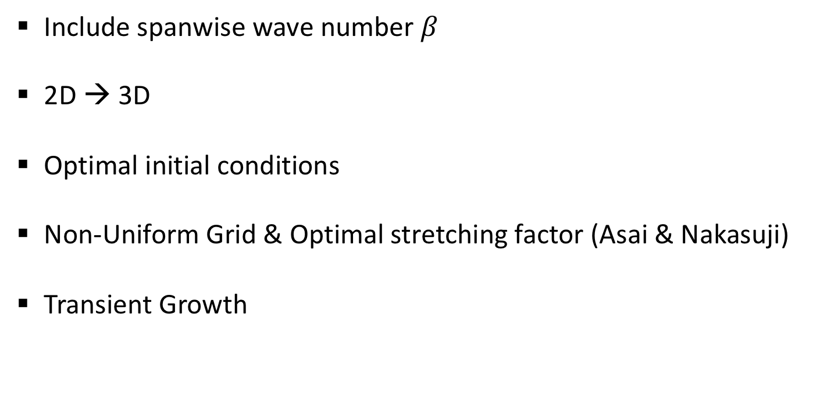
Outlook
Include spanwise wave number $β$
2D → 3D
Optimal initial conditions
Non-Uniform Grid & Optimal stretching factor (Asai & Nakasuji)
Transient Growth
Notes:
Points near branch sensitive to change

Slide 23
References
NASA Video: https://www.youtube.com/watch?v=-D5N_OnZ_Tg
Source Code
Code and Documentation available at GitHub: https://github.com/jousefm/

Slide 24
Questions?

